Slide 1
Admin
Login
Website Management
System
Login
Client
Event info.
Register
User

Slide 2
User Login
Admin Login
1
Login
Admin
---------------
View
Add/Update
User
2
Packages
Admin
Packages
---------------
View
Add/Update
3
Services
Services
---------------
View
Add/Update
4
Cart
Cart
---------------

Slide 3
User
1.1
Provides Login Info
Check Authorize
User
Client
Unauthorized
1.2 Shows Error Message
Authorized
1.3 Redirect to home Page

Slide 4
User
Client
Login
Unauthorized
Redirect to login page
Authorized
Redirect to
Login Page
Book Form
Add To Cart
Display Package
Finalized the form and
process for payment
Continue Viewing
Add Cart
Book
Information
Add Cart Info

Slide 5
User
Select Service
Card Details
Payment = Yes
Payment
Process
Form Process
Payment = No
Payment Done
Redirect To
Home Page

Slide 6

Deshboard
User Login & Register Info
Manage user data
Manage Tickets
Admin
Services
Manage Booking Info.
User Messages
Feedback & Rating
Approve Feedback & Rating

Slide 7
Dashboard
User Login & Register Info
Manage user data
Manage Tickets
Services
Admin
Manage Booking Info.
User Messages
Feedback & Rating
Approve Feedback & Rating

Slide 8
Register
Login
Ticket Book Services
Secure Process
Feedback & Rating
User
Check Feedback & Rating
Secure Payment
Cancel Book Ticket
Ticket Book Form

Slide 9
Register
Login
Ticket Book Services
Secure Process
User
FeedBack & Rating
Check Feedback & Rating
Secure Payment
Cancel Book Ticket
Ticket Book Form

Slide 10
Start
Event Section
Date & Time
Add Event
Event Gallery
No
Yes
View Events
Images
Search Events
Place Location
Event Information
View Events
Details
View Events
Services
Save
Book Event
form
Edit Events
Yes
Yes
Event Login
Done
Payment Process
Success
Event
Register
Yes
Success Book Event
End

Slide 12
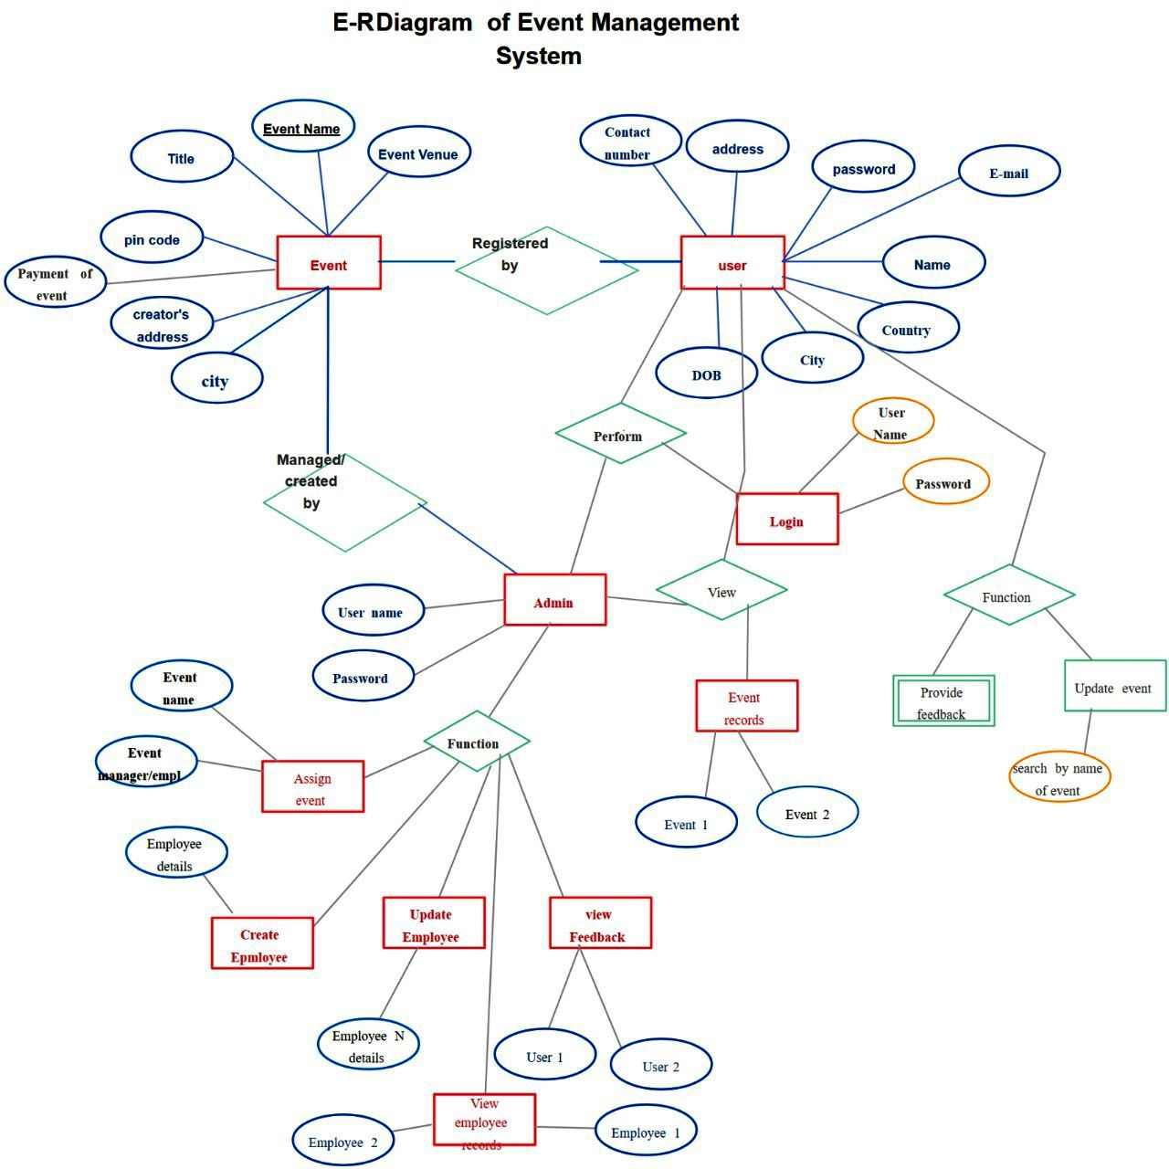



























Event
Name
First Name
Title
Event
Venue
Last Name
Email Id
Contact No.
Address
Event
Registered
By
Country
Payment
of
Event
User
Manager
Details
State
Discount
Area
City
Perform
User
Name
Managed
By
Password
Login
UserName
Admin
View
Function
Event Name
Password
Event
Records
Provide
Feedback
Update
Event
Function
Event Manager
Book Event
Search Event
Event 1
Event 2
Emp. Details
Create Emp
Update Emp
View
Feedback & Reting
Emp 1
User 1
User 2
View
Emp Records
User 3
Emp 2

Slide 13
Start
Registration
Success
Login
Authentication
Invalid
Have Not Register
valid
Process For Ticket Booking
Select
Date & Time
Select
Destination
Select
Coach & Food
Ticket
Price
Payment
Process
Process For Payment
Payment
Amount
Payment
Id
Payment
Status
Generating the Bill
Log Out

Slide 14
Start
Registration
Success
Login
Authentication
Invalid
Have Not Register
valid
Manage
Admin
Registration Data
Manage
Admin
Login Data
Manage
User
Registration Data
Manage
User
Login Data
Manage
Ticket Booking
Data
Log Out
End

Slide 15
Contact Number
Full Name
Contact Number
Full Name
Address
Address
Admin
Modify
User
Email Id
Email Id
Password
Password
Repeat Password
Repeat Password
Manages
Book Ticket
Tourist name
Admin registration data
Tourist age
Admin Login data
Select destination
User registration data
Select coach
User Login data
Select food
Payment Amount
Ticket Booking Data
Tickets counts
Payment ID
Ticket price
Payment
Process
Payment Status

